Slide 1
UNUSUAL SITE OF PILONIDAL CYST
Ths. BS Trần Thị Hoàng Ngâu

Slide 2
Outline
Historical overview
Location of pilonidal sinus
Difference between sacro-coccygeal PNS and unusual site of PNS
Umbilical pilonidal sinus (UPNS)

Slide 3
KEY WORDS: pilonidal sinus of unusual area, pilonidal sinus of atypical area and pilonidal sinus case report, umbilical pilonidal sinus

Slide 4
Historical overview
1833
Herbert Mayo
1847
Anderson
1854 Warren
1956
Patey-Williams
1880
Widely- Hodges
Notes:
Therefore, the beginning dates of many diseases as old as the history of humans is the date that they were written for the first time. This date is 1833 for pilonidal sinus disease. Herbert Mayo, British Physiologist, Anatomist and Surgeon (3rd April 1796-28th June 1852), described it as a sinus containing hair follicles located in the sacrococcygeal region in a woman, in 1833[1,2].
Afterwards, an article named “Hair Extracted from an Ulcer” published by Anderson[3] in “Boston Medical Surgical Journal” in 1847 was found. He reported a case of a 21-year-old male with a Scrophuloderma on his back, in his article written as a letter to the editor. He reported that he drained the cavity after 3 wk and a structure looking like a mesh made of multiple hairs of 2 inches long and after complete drainage and cleaning of the hair in the cavity, the wound healed quickly[3,4]. Seven years later, in 1854 Warren reported 3 similar cases and this study is the first case series known in the history of pilonidal sinus disease[5].
The disease was given many names until 1880. Widely used ones are; sacral, coccygeal or sacrococcygeal infundibulum, dermoid and dermoid fistula, congenital dermal sinus and sacrococcygeal ectodermal sinus[6].
Eventually, in 1880, Hodges[7] named the disease with the statement of “I venture to give the name of pilo-nidal (pilus, a hair, nidus, a nest) sinus to this rather singular lesion.” He produced the word “pilonidal” by conjoining the word “pilus” which means hair in Latin and “nidus” which means nest[8]
The first case of an umbilical pilonidal sinus was reported in 1956 by Patey and Williams, ⁽³⁾ and since then, only a few hundred cases have been reported in medical literature.

Slide 5
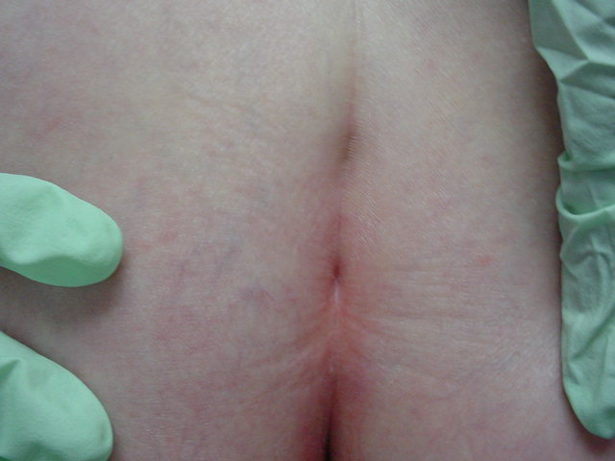
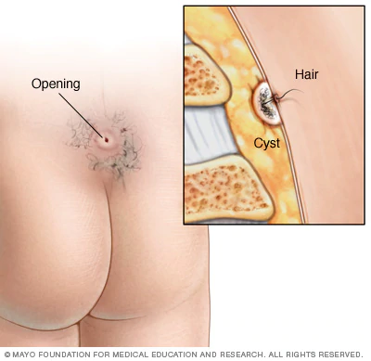
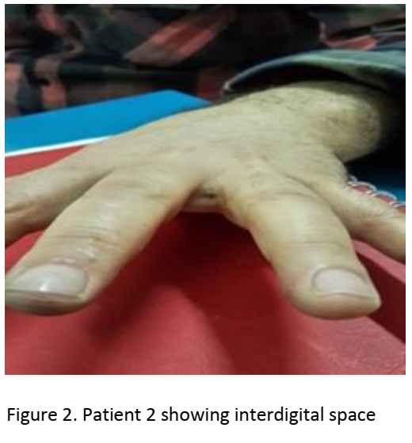
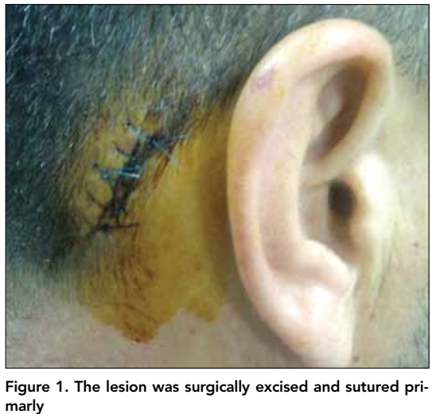
Location of pilonidal sinus
Pilonidal cyst
Notes:
1/ https://www.mayoclinic.org/diseases-condi
https://www.dermatologyadvisor.com/dermatology/pilonidal-sinus-disease-pilonidal-cyst/article/691420/
2/ Approach To Interdigital Pilonidal Sinus – Extended case report and literature summary Pilonidal Sinus Journal (2016) 2(1), 5 - 12
3/ Pilonidal Sinus of the Scalp: a Case Report and Review of the Literature Balkan Med J 2011; 28: 445-7

Slide 6
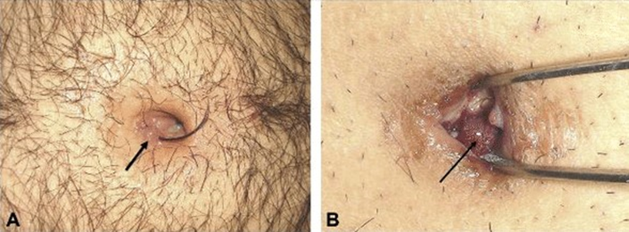
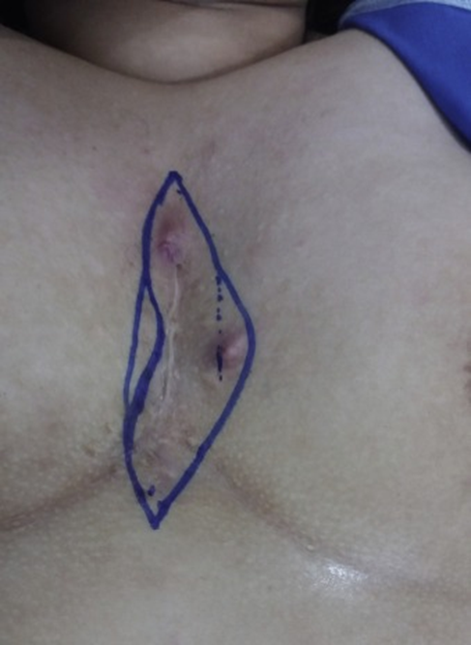
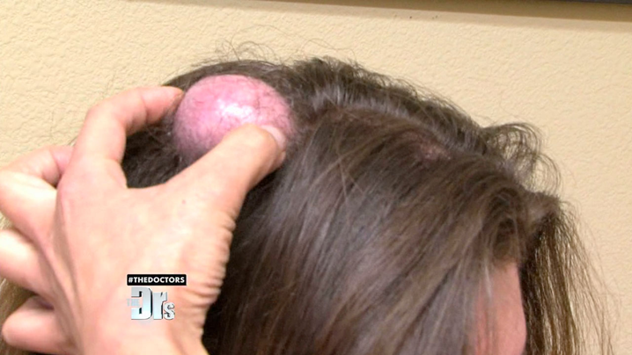
Location of pilonidal sinus
Notes:
4/ Conservative vs Surgical Interventions for Umbilical Pilonidal Sinus: A Multicenter, Double-Blind, Prospective, and Randomized Clinical Trial
5/ https://origin.thedoctorstv.com/tags/pilonidal-cyst
6/ Intermammary pilonidal sinus: The first case series volume 41 2017, Pages 265-268

Slide 7
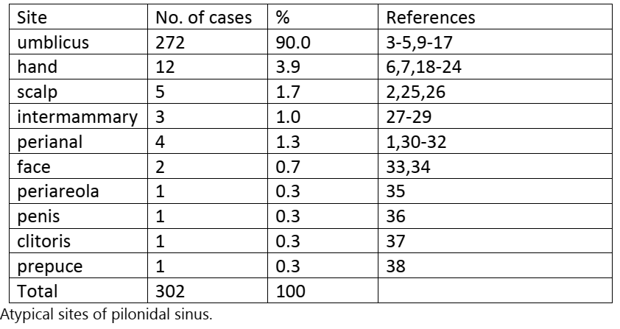
Unusal location of pilonidal sinus

Slide 8
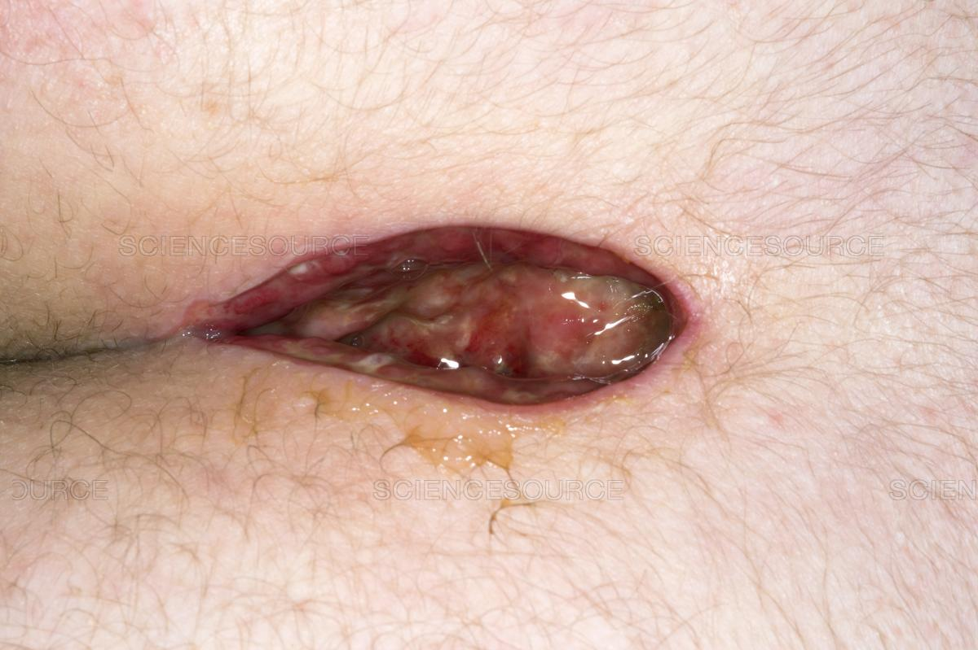
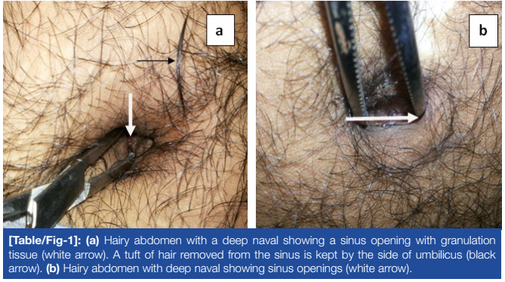
Difference between sacro-coccygeal PNS and unusual site of PNS
UPNS and sacro-coccygeal PNS → the method of management.
Notes:
In sacro-coccygeal PNS, conservative management has minimal role and the condition requires excision (drainage if there is collection) with either off midline primary closure or daily dressing having left the wound for the secondary healing. However, umbilical PNS can be successfully treated by conservative measures provided that the hair is removed and daily dressings applied. Removal of hair in umbilical PNS does not even need local anesthesia Sacro-coccygeal PNS is a recurring condition with recurrence rates of 15% being often reported, while PNS in atypical areas (including umbilical) has lower recurrence rate as low as 2%
image
1/ https://www.sciencesource.com/archive/Post-surgery-pilonidal-sinus-wound-SS2762694.html (Open wound of a pilonidal sinus above the buttocks of a 21 year old female patient five days after surgery. A pilonidal sinus is a pit formed when hairs grow inwards into the skin. Surgery treats the condition and the wound is left open to heal.
2/ Umbilical Pilonidal Sinus: A Report of Two Cases and Recent Update of Literature (Journal of Clinical and Diagnostic Research. 2016 Sep, Vol-10(9): PD20-PD22)

Slide 9
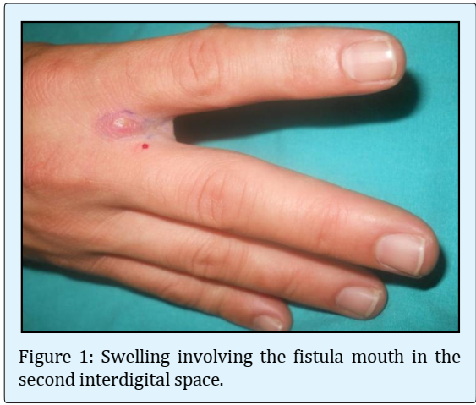
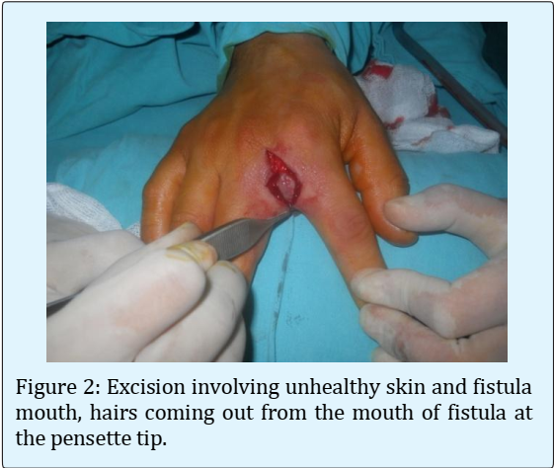
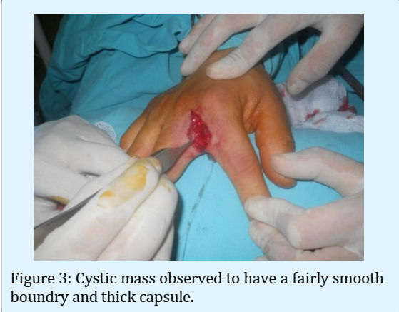
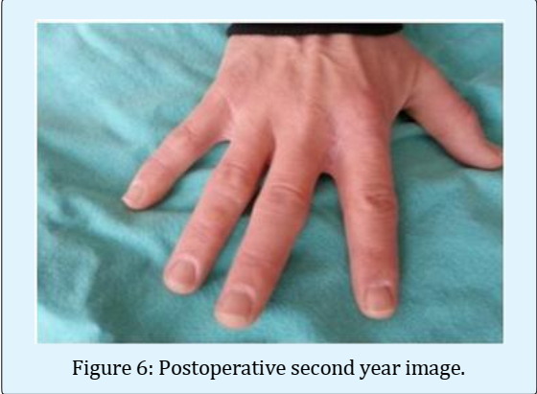
Difference between sacro-coccygeal PNS and unusual site of PNS
Barber's disease = PNS of the hand
Notes:
While sacro coccygeal PNS occurs often in drivers, Barber’s disease occurs in hair dressers, sheep shearers, dog groomers and cow milkers. It is reported more commonly among male hair dressers. Higher incidence of Barber's disease among male gender might be attributed to more frequent female obsessive personality regarding cleansing of interdigital webs or that most barbers are male

Slide 10
Difference between sacro-coccygeal PNS and unusual site of PNS
Scalp PNS is reported in teenagers and children ranging between 1 to 20 years with average 10 years of age.
This differentiates scalp PNS from other types of PNS which tend to occur in older adults (average 23 years old).
Excision under local anesthesia is the most common modality of treatment with no report of recurrences.
Notes:
Borges et al reported a scalp pilonidal sinus in a 20-year-old male with intracranial extension which needed craniotomy under general anesthesia. This may alert doctors to investigate scalp PNS before intervention searching for intracranial extension. Plain antero-posterior skull x-ray may be the first investigation, followed by brain Computed Tomography

Slide 11
Difference between sacro-coccygeal PNS and unusual site of PNS
Perianal PNS occurs in adults older than typical PNS (average 34 years old).
Excision under regional anesthesia is the usual therapeutic approach.
Notes:
Doll et al reported a 61-year-old lady presenting with intermittent anal pain for 10 years due to endoanal PNS treated by opening the cavity and leaving for healing by secondary intension

Slide 12
Difference between sacro-coccygeal PNS and unusual site of PNS
Intermammary PNS presented with pain and discharge treated by excision and primary repair.
Perineal PNS presented with pain on defecation with discharge, treated with drainage and was left for healing by secondary intention.

Slide 13
Difference between sacro-coccygeal PNS and unusual site of PNS
Penile PNS presented with abscess formation treated by excision and primary closure.
Clitoris PNS presented with swelling and pain - treated with excision and primary closure.
Prepuce PNS presented with swelling and discharge - treated with excision and primary closure

Slide 14
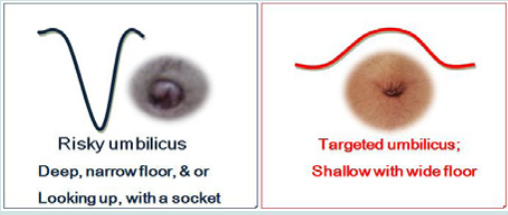
Umbilical pilonidal sinus (UPNS)
Shows the difference between risky and less risky umbilicus
Notes:
Umbilical Pilonidal Disease; Predisposing Factors & Best Modality of Management J Surgery 6(2): 4 (2018)

Slide 15
Umbilical pilonidal sinus (UPNS)
Risk of UPNS
Male gender
Obesity
Hairy body
Tight clothing
Deep naval
Poor personal hygiene

Slide 16
Umbilical pilonidal sinus (UPNS)
Differential diagnosis
Sister Joseph nodule
umbilical hernia
Endometriosis
urachal cyst
epidermoid cyst
pyogenic granuloma
→ Preoperative imaging

Slide 17
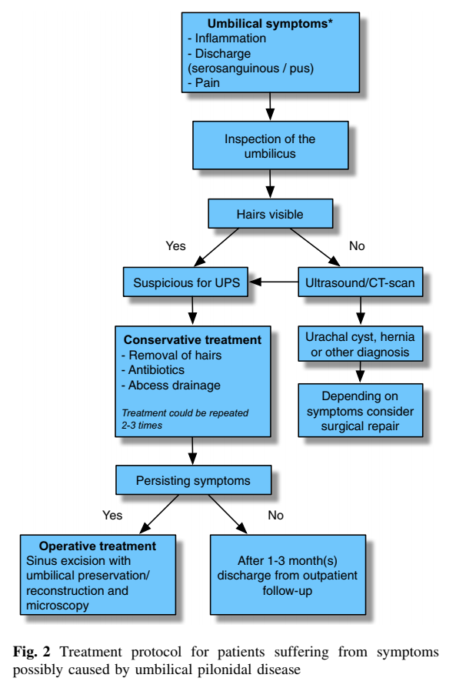
Umbilical pilonidal sinus (UPNS)

Slide 18
Thank you
for your attention

